Slide 1

SCHOOL OF SCIENCE AND HUMANITIES
DEPARTMENT OF COMPUTER SCIENCE
III BSC CS AI
CRYPTO VIEW – REAL TIME INR CRYPTO ANALYTICS
Guide: Ms. Saranya P
Dinakar T - 43735009
Ajith R - 43735039

Slide 2

ABSTRACT
The rapid growth of cryptocurrency markets has created a need for accurate, real-time, and user-friendly analytical platforms. Many investors and traders face difficulty in tracking multiple crypto assets, market trends, and risk factors simultaneously. This project presents a client - side crypto analytics platform.The system collects live cryptocurrency data using secure apis and proxy servers. It analyzes market price, volatility, trends, and behavior patterns. An ai-powered module generates intelligent summaries and predictions. The system also supports sharing, exporting, and restoring analysis environments. This project solves the problem of scattered crypto information and lack of intelligent decision support. The proposed system provides a centralized, automated, and interactive platform for crypto market analysis.

Slide 3
INTRODUCTION
However, crypto markets are highly volatile and unpredictable. Most beginners and small investors lack proper tools for analysis. Existing platforms provide raw data but limited interpretation. Users often switch between multiple websites and apps. This leads to confusion, poor decision-making, and financial losses.Our project aims to. simplify crypto analysis using modern web technologies. It integrates live data, visualization, ai insights, and sharing features. The system acts as a digital assistant for crypto traders. It helps users understand market behavior easily and accurately.

Slide 4
EXISTING SYSTEM
Investors mainly rely on:
Coin tracking websites
Mobile trading apps
Spreadsheet-based analysis
Social media recommendations
Most platforms provide:
Live price updates
Basic charts
News feeds
Analysis is mostly manual.
Ai-based interpretation is rarely available.
Data from different sources is not integrated.
Sharing customized analysis is difficult.
No environment restoration facility is provided.
Users depend on external tools for advanced insights.

Slide 5
DEMERITS - PROBLEM STATEMENT
The application lacked reliable financial conversion and secure data management features, limiting its usability and portability. Specifically:
There was no accurate or real-time conversion system for USDT to INR, causing inconsistencies in financial reporting.
Users were unable to share their data easily through a permanent, accessible format such as a static web page.
The system did not support secure exporting of data into standard formats like JSON with protection mechanisms.
There was no way to restore the UI from previously exported data files making recovery and migration difficult.
As a result, users faced challenges in data sharing, security, backup, and continuity of their work across devices or sessions

Slide 6
PROPOSED SYSTEM
Development of an crypto analytics dashboard.
Converts USDT to INR real time
Provides real-time data through api proxies.
Displays price, volume, volatility, and trends.
Includes ai-based market summary generator.
Allows users to create environment snapshots.
Supports shareable links and qr codes.
Enables export in json and pdf formats.
Restores previous sessions using shared links and downloaded files.
Ensures data security using proxy servers.
Provides responsive and user-friendly interface.
PROBLEM SOLVED
Integrated accurate USDT to INR conversion.
Provided a feature to share data as a static page via a shareable link.
Implemented JSON/pdf file export with secure keycode support.
Added functionality to restore the UI using exported files.

Slide 7
CORE INNOVATIONS
JSON State Restore Engine (JSRE)
Captures the complete running data of the application at a given moment.
Converts all information into a structured JSON format.
Reloads the application when JSON is uploaded back.
Recreates the same environment at the Captured moment.
Crypto Session Rendering Engine
Captures the complete running data of the application at a specific moment.
Converts the captured data into a compressed, encoded format embedded in a URL.
Long URLs are shortened and provided as a shareable link and QR code.
Allows the same session to be opened and rendered exactly in environment.
Real-Time INR Conversion System
Converts crypto prices from **USDT** to **INR** instantly.
Updates all displayed values dynamically when the currency is changed.
Maintains the same converted values in JSRE and CSRE.
Provides a consistent price view for users.
Problem
No accurate real-time **USDT to INR** conversion, leading to inconsistent values.
No simple way to share data as a shareable link.
No secure method to export structured data (JSON).
No mechanism to restore the UI from previously saved data.

Slide 8
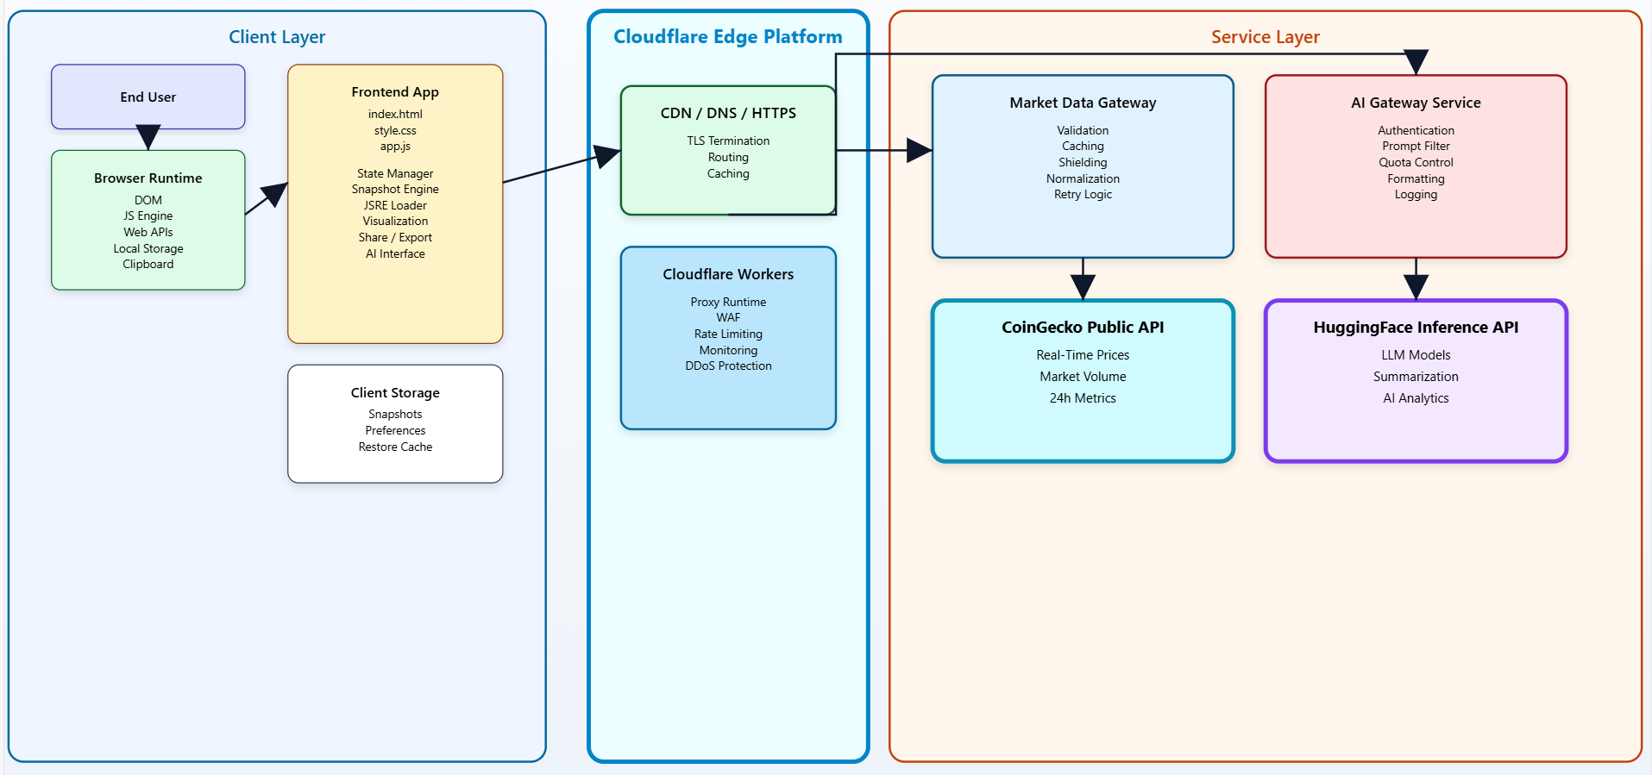
SYSTEM ARCHITECTURE

Slide 9
ADVANTAGES
Centralized crypto analysis platform.
Real-time data visualization.
AI-assisted decision support.
Easy sharing of analysis environments.
Reduced dependency on multiple tools.
Faster market understanding.
Improved trading efficiency.
Beginner-friendly interface.
Secure API communication.
High scalability.
Better user engagement.
Cost-effective solution.

Slide 10
LIST OF MODULES
User Interface Module
  HTML layout
  Modals, buttons, and dialogs
  Responsive design
State Management Module
  Central state object
  Current symbol, prices, currency, restore mode
Transport Module
  Binance WebSocket connection
  CoinGecko REST fallback
Snapshot & JSRE Module
  Snapshot generation
  Compression and encoding
  Restore engine and overlays
AI Module
  Prompt generation
  AI request handling
  Summary display
Worker Proxy Module
  CoinGecko API proxy
  Hugging Face AI proxy

Slide 11
ENVIRONMENTAL REQUIREMENTS
Software Requirements:
• Operating System: Windows 10 or later
• Front-end: HTML, CSS, Vanilla JavaScript
• Back-end: Cloudflare Workers (JavaScript)
• Database: Not Required (Client-side state management)
• APIs Used: Binance WebSocket API, CoinGecko REST API, Hugging Face Inference API, Coudflare Workers API, Exchange Rate API, TinyURL API, QR Code Generator API
• Web Browser: Google Chrome / Mozilla Firefox / Microsoft Edge
Hardware Requirements:
• Processor: Intel i3 or higher
• Hard Disk: Minimum 10 GB
• RAM: Minimum 4 GB

Slide 12
LITERATURE SURVEY
S.no | Title | Author and Year of Published | Description | Citation
1 | Real-Time Data Extraction and Prediction of Cryptocurrency | Sanika Rajesh Chavan, Jahnavi Gundakaram, Sai Dyuti Vaishnavi, Srishti Prasad, K. Deepa (2024) | Proposes a real-time data collection system via web scraping from live crypto sources, then applies deep learning (LSTM, GRU, XGBoost) for short-term price forecasting, integrated into a dashboard. This is directly aligned with your project’s real-time price capture, prediction, and visualization goals. | Chavan, S.R., et al., “Real-Time Data Extraction and Prediction of Cryptocurrency,” IEEE Access, 2024. DOI:10.1109/ACCESS.2024.3513034.
2 | Cryptocurrency Price Prediction: A Comprehensive Analysis of High-dimensional Features with Deep Learning Techniques | Nrusingha Tripathy, Subrat K. Nayak, Sarbeswara Hota, Sasanka S. Dalai (2024) | Presents ML and DL methods (ARIMA, GRU, LSTM, XGBoost) for time-series prediction of crypto prices, analyzing model performance on Bitcoin data. This supports forecasting analytics within your app UI. | Tripathy, N., et al., “Cryptocurrency Price Prediction: A Comprehensive Analysis…,” IEEE IC-SIT 2024. DOI:10.1109/IC-SIT63503.2024.10862895.

Slide 13
LITERATURE SURVEY
S.No | Title | Author and year of published | Description | Citation
3 | A deep learning-based cryptocurrency price prediction model using on-chain data | G. Kim, D.H. Shin, J.G. Choi, S. Lim (2022) | Uses on-chain information + deep learning for price prediction, demonstrating the value of blockchain-specific features in forecast accuracy—this can extend your project’s analytics features. | Kim, G., Et al., “A deep learning-based cryptocurrency price prediction model that uses on-chain data,” IEEE access, 2022.
4 | Comparative analysis of deep learning techniques for cryptocurrency forecasting | B. Birvan (2023–2025) | Several ieee-indexed papers compare LSTM, GRU, bi-lstm models for forecasting crypto prices with high volatility, useful for choosing forecasting back-ends. Common evaluation metrics include MAE, rmse—critical for accuracy evaluation in predictive modules. | Rao, K.R., Et al., “Time-series cryptocurrency forecasting using ensemble deep learning,” IEEE conference on power, signal and information technology (APSIT), 2023.

Slide 14
LITERATURE SURVEY
S.no | Title | Author and Year of Published | Description | Citation
5 | Enhancing Bitcoin Price Prediction Using Fractional Grey Models and Machine Learning | Y. Yang, J. Xiong, L. Zhao, et al. (2023) | Presents a hybrid model combining fractional grey models with ML, useful for extended forecasting, particularly where data dynamics are nonlinear and volatile. | Yang, Y., et al., “A Novel Method of Blockchain Cryptocurrency Price Prediction Using Fractional Grey Model,” IEEE Transactions, 2023.
6 | Time-Series Cryptocurrency Forecasting Using Hybrid Deep Learning Models | S. Shawn Lee (2023–2025) | Research comparing Hybrid LSTM-GRU and 1D CNN models for improved price movement prediction; helpful for higher-frequency forecasts proximate to your real-time dashboard. | Rao, K.R., et al., “Time-Series Cryptocurrency Forecasting Using Ensemble Deep Learning,” IEEE Conference 2025.

Slide 15
LITERATURE SURVEY
S.no | Title | Author and Year of Published | Description | Citation
7 | Forecasting Cryptocurrency Volatility Using Statistical and Machine Learning Models | G. Donald (2024) | Discusses approaches to cryptocurrency volatility forecasting, important when computing volatility metrics in your analytics UI and alerts features. nonlinear and volatile. | Dudek, G., “Forecasting Cryptocurrency Volatility Using Statistical and ML Methods,” Journal Article, 2024.
8 | Ensemble Deep Learning for Short-Term Cryptocurrency Movement Prediction | A. Rivan (2022) | Examines ensemble models (LSTM, RNN, CNN combinations) achieving robust prediction performance, relevant for risk indicators and anomaly detection modules. | IEEE Conference proceedings on ensemble DL (2024).

Slide 16
LITERATURE SURVEY
S.no | Title | Author and Year of Published | Description | Citation
9 | Streaming Real-Time Financial Data Analytics Frameworks | G. Dudek (2024) | While not specific to crypto, frameworks for real-time streaming analytics (e.g., Spark) can inform the architecture of your real-time data ingestion and processing pipeline (similar to Binance WS handling). | Khan, M.A.A., et al., “Nowcasting Financial Time Series with Streaming Data Analytics under Apache Spark,” 2022.
10 | Order Flow and Market Microstructure Analysis in Crypto Markets | D. Rutheren (2023) | Not IEEE but highly relevant; studies order flow imbalance vs price change—this underpins risk and microstructure metrics you visualize in your analytics panels. | Silantyev, E., “Order Flow Analysis of Cryptocurrency Markets,” Digital Finance Journal, 2019.

Slide 17


